Slide 1
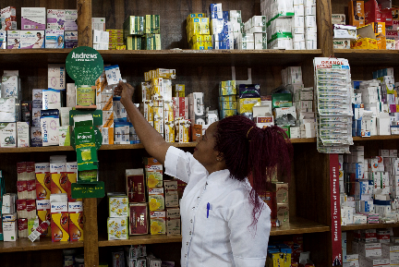

[COUNTRY, YEAR]
Module 1:
Study and training intro

Slide 2
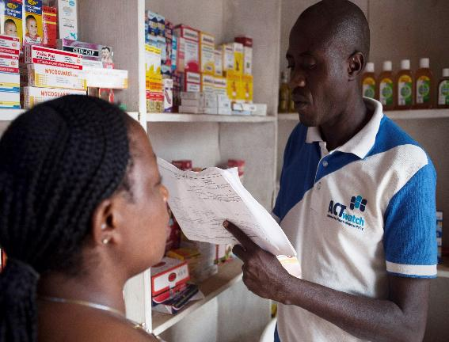
Agenda
1.1 Presentation of the training agenda
1.2 Ground Rules and Expectations
1.3 Training objectives
1.4 Malaria context
1.5 ACTwatch Lite overview

Slide 3
Registration and introductions
Sign in using the registration sheet provided by your training facilitators
Introductions! Can everyone share:
What is your name?
Where are you from?
Background/institution
Any experience with ACTwatch?
Your favorite food?

Slide 4
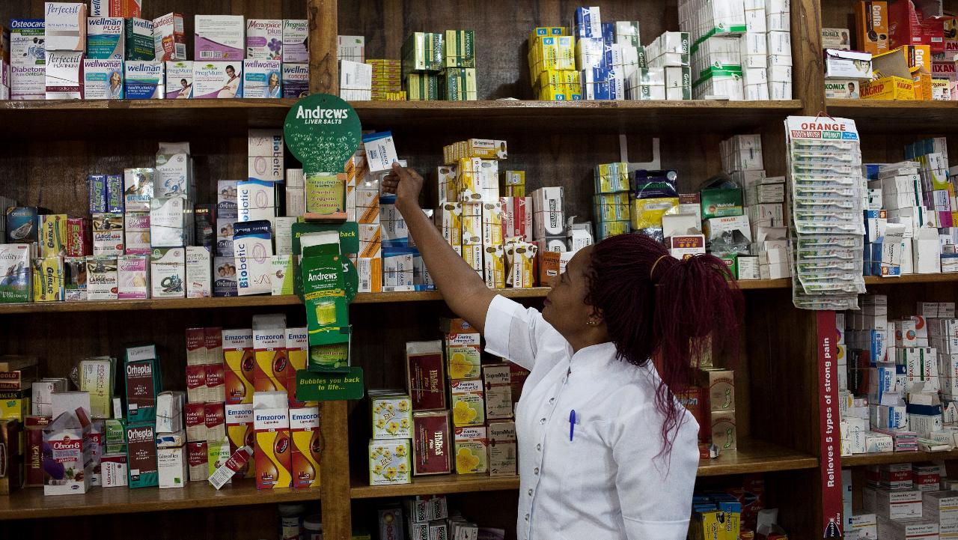
1.1 Presentation of the training agenda

Slide 5
INSERT SCREENSHOT OF AGENDA for YOUR TRAINING HERE. THIS SHOULD ALSO BE PRINTED AND SHARED WITH PARTICIPANTS.

Slide 6

1.2 Ground Rules and Expectations

Slide 7
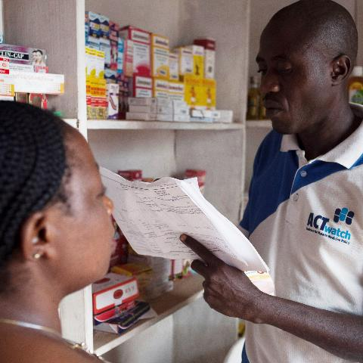
What rules and expectations should we have for this training?

Slide 8

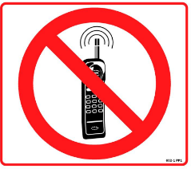
Rules:
Do not be late to training, after breaks, or lunch. Please do not leave the training before the end of the day. Arriving late without a valid reason will result in disqualification.
Switch off your phones or put them on silent mode. No laptops or other electronic devices should be used outside of break times.
All tests and exercises are compulsory. Cheating will result in disqualification.

Slide 9

Expectations:
Ask questions.
Help each other.
Use inclusive language.
Respect the comments and opinions of others.
Share your suggestions or comments with the trainers to improve the session.
If you feel the trainer is going too fast, you can ask him to slow down a little.

Slide 10

End of session 1.2
Thank you for your attention!
Any questions?

Slide 11
1.3 Training objectives

Slide 12
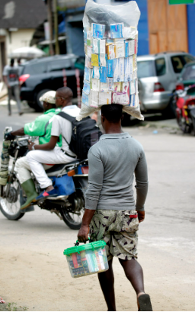
Training Objectives:
Understand the ACTwatch Lite study and the role of qualitative research
Learn techniques for conducting effective in-depth interviews
Become familiar with the discussion guide and ethical interviewing practices
Practice interviews through role-play and a field pre-test
Gain skills in transcription, translation, and data management
Prepare for field logistics, respondent coordination, and teamwork

Slide 13
End of session 1.3
Thank you for your attention!
Any questions?

Slide 14
1.4 Malaria context

Slide 15
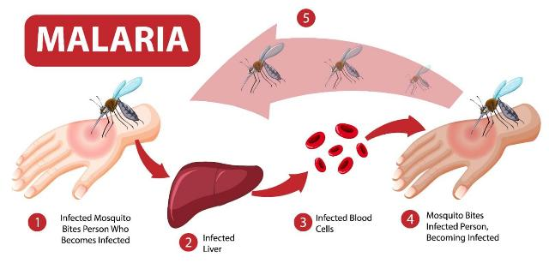
WhAT IS MALARIA?
Definition: Malaria is a potentially fatal febrile disease caused by Plasmodium parasites, transmitted by infected female Anopheles mosquitoes.
Symptoms: Includes fever, chills, headache, nausea, and muscle pain; severe cases can lead to organ failure.
Types of Plasmodium: Five species infect humans; Plasmodium falciparum and Plasmodium vivax are the most common.

Slide 16
Uncomplicated malaria and severe malaria
Uncomplicated Malaria | Severe Malaria
Can be caused by all Plasmodium species. Symptoms generally occur 7-10 days after the initial mosquito bite. Symptoms are non-specific and can include fever, moderate to severe shaking chills, profuse sweating, headache, nausea, vomiting, diarrhoea and anaemia, with no clinical or laboratory findings of severe organ dysfunction. | Severe malaria is usually caused by infection with Plasmodium falciparum. Complications include severe anaemia and end-organ damage, including coma (cerebral malaria), pulmonary (lung) complications (for example, oedema and hyperpnoeic syndrome) and hypoglycaemia or acute kidney injury. Severe malaria is often associated with hyperparasitaemia (very high levels of malaria parasites in the blood) and is associated with increased risk of death.

Slide 17
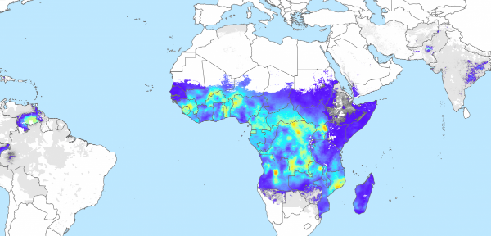
Epidemiological situation - Worldwide
Key facts
Globally in 2022, there were an estimated 249 million malaria cases and 608,000 malaria deaths in 85 countries.
The WHO African Region carries a disproportionately high share of the global malaria burden.
In 2022, the Region was home to 94% of malaria cases (233 million) and 95% (580,000) of malaria deaths.
Children under 5 accounted for about 80% of all malaria deaths in the Region.
Note: update this slide with the most recent World Malaria Report or other relevant data source
Source: Malaria Atlas Project
Source: https://www.who.int/news-room/fact-sheets/detail/malaria
29 May 2024

Slide 18
Epidemiological situation – [COUNTRY]
To be updated with current country data. A graphic with geographical impact is suggested to be added here as a visual
Malaria is a major public health concern in [country]
~XX cases and XX deaths due to the disease in [year].
[Country] accounts for nearly XX% of the global malaria burden.

Slide 19
MALARIA Prevention
There are several strategies and interventions to prevent infection and reduce transmission of malaria in at-risk communities:
Vector control
Insecticide-treated mosquito nets
Intra-domiciliary spraying (IDS)
Larval source management
Chemoprophylaxis (travelers)
Chemoprevention (IPTp, PMC, SMC, PDMC, MDA)
Vaccination (RTS,S/AS01; R21)
Combining strategies

Slide 20
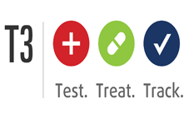
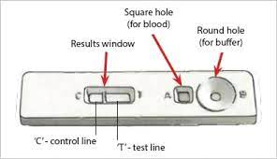
Malaria diagnosis
Policy: Since 2010, the WHO has adopted a test, treat, and track policy, recommending all suspected cases of malaria (fevers) are tested.
Test types: The most common tools are Microscopy and malaria Rapid Diagnostic Tests (RDTs).
Importance of Prompt Diagnosis: Early and accurate diagnosis is crucial for effective treatment and preventing severe complications.
Challenges: Limited access to diagnostic tools in rural and resource-poor areas, and potential for false negatives in low-parasite-density infections.
RDTs

Slide 21
MALARIA Treatment
Have you ever had malaria?
What treatment did you receive?
The first-line treatment for uncomplicated malaria is Artemisinin-based Combination Therapies (ACTs).
For severe cases* treatment may be artesunate/artemether injection, artesunate suppository†, quinine injection, followed by a full course of ACT.
The specific drug prescribed will vary depending on:
Type of malaria
Parasite resistance to a drug
Weight or age, pregnant or not
*Severe malaria occurs when infections are complicated by serious organ failures or abnormalities in the patient’s blood or metabolism.
† Use of the artesunate suppository is strictly for pre-referral management.

Slide 22
End of session 1.4
Thank you for your attention!
Any questions?

Slide 23
1.5 ACTwatch Lite overview

Slide 24
ACTwatch IS THE key source of data on the availability, price, and market share of malaria commodities IN THE PRIVATE SECTOR
ACTwatch malaria market studies have been conducted since 2007 and generate malaria treatment, diagnostic and provider data from formal and informal private sector outlets and their supply chains
Findings have been used by national malaria programs, donors, and implementing partners to inform strategic planning, improve regulatory enforcement, target behavior change interventions, and guide subsidy and distribution policies to expand access to quality-assured malaria commodities.
[IF OTHER ACTWATCH OR SIMILAR MARKET STUDIES HAVE BEEN CONDUCTED PREVIOUSLY, ADD SUMMARY OF RESULTS HERE]

Slide 25
The ACTWATCH LITE PROJECT IS A Streamlined multi-country market study:
Tools have been updated to use electronic data collection and take advantage of a database of known malaria products to reduce data collection times.
Methods have been focused to private sector outlets.
As a result → data, methodology and tools are made rapidly available to National Malaria Programs & stakeholders for an up-to-date understanding of private sector malaria markets to inform strategic and programmatic decision-making for private sector case management.
Note to presenter: an editable map of the African continent is provided. The implementation country can be filled in with a different color.

Slide 26
Why [COUNTRY]?
[Country]’s private sector (formal and informal) is a major source of care (X% of care seeking for fever in 20XX *note this should be available from the most recent DHS or MIS)
Quality of treatment practices, product availability, and provider capacity in the informal sector are not known.
A key barrier to progress is a lack of robust, contemporary data on private sector malaria markets that can be used by national decision-makers and their global partners to support appropriate intervention design.
[Insert additional reasons for why ACTwatch lite is being implemented in your country.]
Therefore, monitoring the private sector, including gathering high quality and actionable data on outlet practices and AM / RDT availability, price, etc. is essential in meeting objectives of [Country’s] National Malaria Strategic Plan (Insert Year - XXXX)
To be updated with current country data.
Suggestion: Add country flag to the right of the country name.

Slide 27




An ACTwatch Lite study typically has two components:
1
Interviews with supply chain actors for antimalarials and RDTs at the national level.
Retail-level outlet survey among private sector outlets providing antimalarials and/or RDTs and diagnostic testing services to the general population.
+
Suppliers (e.g. wholesalers) providing antimalarials and RDTs to outlets targeted at the retail-level.
2
Commune
Ross et frères
Laveran Ets
Laveran Ets
Laveran Ets
Ross et frères
Marché
Ross et frères
Laveran Ets
3
Commune

Slide 28
DESIGN, METHODS, AND SCOPE
To be updated with information from the current project country protocol

Slide 29
Fieldwork, Data analysis and Use
To be updated with information from the current project country protocol

Slide 30
Key Themes assessed through these interviews include:
Theme | Relevance
Product and market characteristics | Understand sourcing decisions and availability of malaria products
Pricing and revenue | Uncover factors influencing price setting and profit margins on ACTs and RDTs
Distribution | Identify supply chain gaps or inefficiencies (e.g., online ordering trends, stock-outs)
Competition | Assess market saturation or dominant players impacting ACT availability
Regulations | Understand gaps in licensing, enforcement, and informal markets
Risks and challenges | Contextualize private sector challenges and potential policy or technical solutions
To be updated with information from the current project country protocol

Slide 31
End of session 1.5
Thank you for your attention!
Any questions?

